Slide 1
Racial Bias Analysis of Investigatory Stop Reports from the Chicago Police Department, 2018-2019
Jay Reiter
July 2020

Slide 2
Introduction

Slide 3
Investigatory Stops
“Stop and Frisk” investigation method used by Chicago Police Department
Involves any of the following:
Threatening presence of several officers
Display of a weapon by officer
Use of language or tone of voice indicating that compliance with the officer's request might be compelled
Officer blocks person’s path
Choice to end the encounter is not available to the person

Slide 4
Investigatory Stops
Notorious for disproportionately targeting people of color
CPD’s ISR policy states (Article III, Section E):
“Department members will not engage in racial profiling or other bias- based policing when conducting Investigatory Stops.”
Investigatory stops do not require probable cause
Offices need only have “reasonable, articulable suspicion”
Not the same as “evidence”
Facilitates Bias

Slide 5
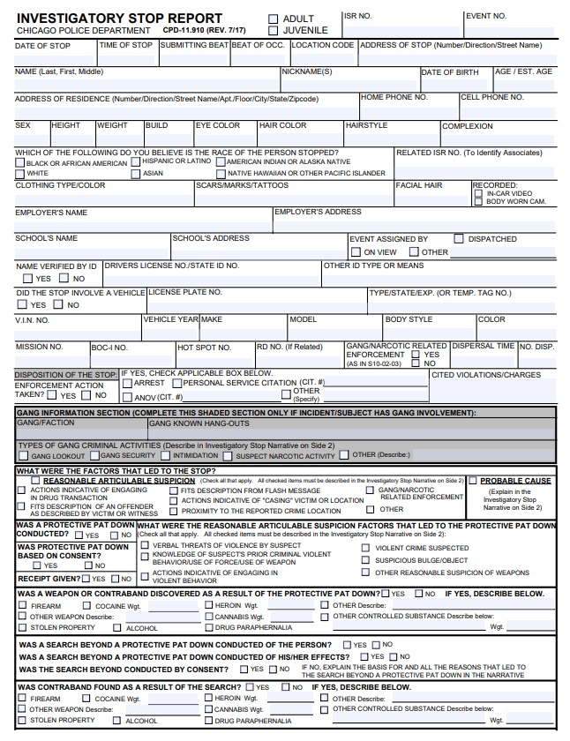
Investigatory Stops
Each investigatory stop is reported by
the investigating officer using this form:
Includes suspect details such as:
- Suspect name, date, location
Hair color, race, sex
Investigative techniques used
Legal violations found
Enforcement action taken

Slide 6
Motivation
Investigatory stops facilitate police racial profiling
Since they do not require probable cause, they are by definition escalation
Escalation may lead to excessive violence, enforcement
The objective of this study is to use data to expose the extent of racial bias in the Chicago Police Department
Educate voters, citizens, potential victims of police violence
Encourage open criticism of policing in America
This is a matter of human rights; we are not free until everyone is.

Slide 7
Data Used

Slide 8
Data Used
Results from more than 290,000 investigatory stops between 2018 and 2019 are used in this study
Openly available on the CPD’s website
Each event includes all the data available on the ISR form
Chicago racial demographic data from the 2018 United States Census is also used in part of this study

Slide 9
Results and Discussion

Slide 10
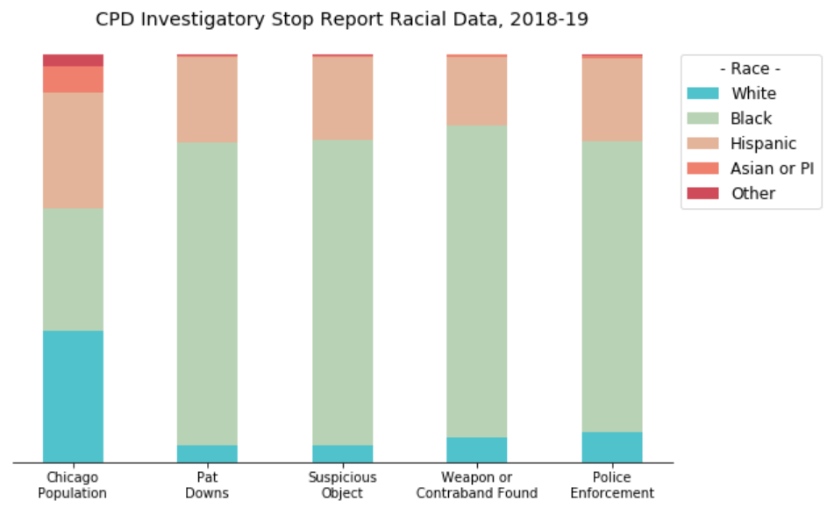
Plot of US Census data and 290,000 entries of ISR data from CPD. The first column is drawn from US Census data, while the latter four are from CPD ISRs. Races are ordered by proportion of the Chicago population. It should be noted that the latter four columns are based off of officers' perception of suspects' races and may not always be accurate.

Slide 11
Interaction Result Study
Rate of invasive investigative techniques is clearly disproportionate among racial groups
Black people are the only group to experience a higher proportion of investigatory stops than their proportion of the Chicago population
Rate at which Black (white) people face enforcement is less (greater) than the rate at which they receive pat downs
Suggests that police are overly suspicious of Black people and underly suspicious of white people
Latinx face similar, though less extreme disproportion of stops to Black people

Slide 12
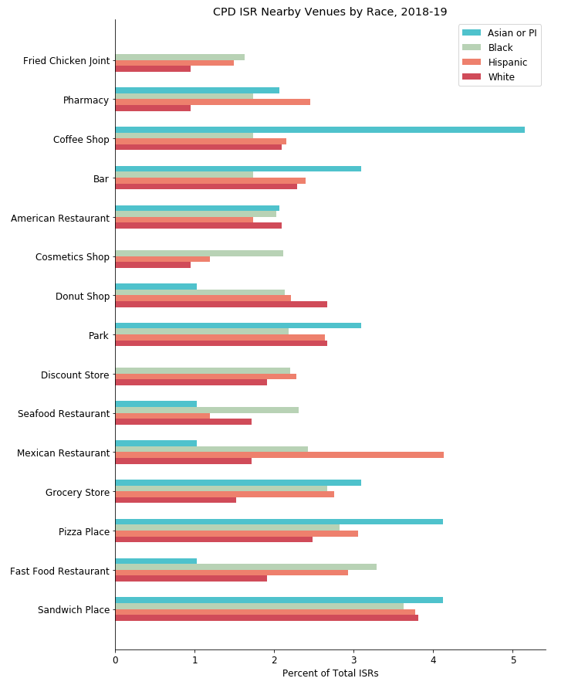
This plot depicts the relative frequency of venue categories near which police investigatory stops occur in Chicago, arranged by the race of suspects. Bars indicate the percent of total ISRs filed against suspects of each race. For example, about 3.9% of ISRs involving Black suspects occur near a sandwich place. This plot is based on approximately 800 events.

Slide 13
ISR Vicinity Study
Because of the relatively small sample size in this chart, most discrepancies could be attributed to noise in the data set
Particularly with Asian and Pacific Islander data since those represent only 50 entries in this sample set
Thus, this chart tells us little new information
More a description of the prevalence of different types of venues than anything else

Slide 14
Ubiquity of Racial Bias in CPD Study
Next we observe the frequency of different enforcement options by officer in investigatory stops
These are the types of enforcement listed on the ISR form:
None: suspect is released
Arrest: suspect is arrested
PSC: personal service citation (a ticket)
ANOV: administrative notice of ordinance violation (less severe ticket)
Other: unspecified

Slide 15
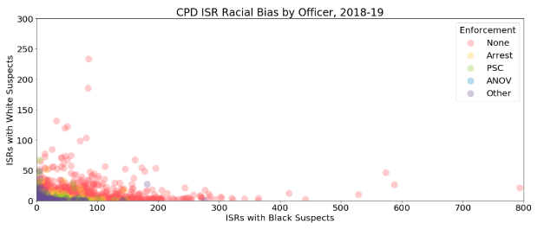

Slide 16
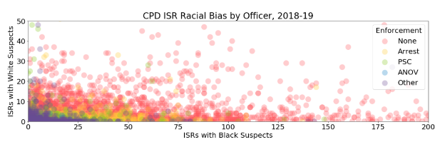
Same as the previous plot but enlarged around the origin to show detail

Slide 17
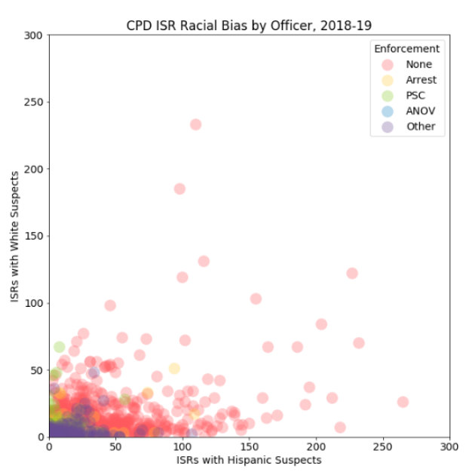

Slide 18
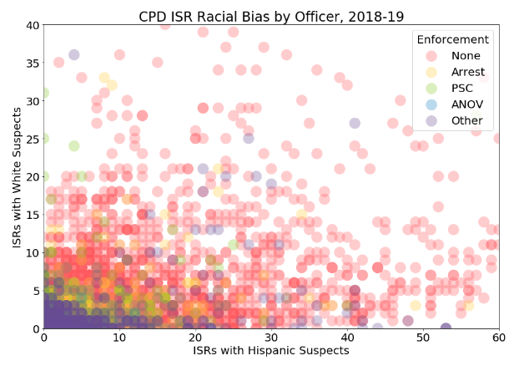
Same as the previous plot but enlarged around the origin to show detail

Slide 19
Ubiquity of Racial Bias in CPD Study
Clear department-wide display of racial bias favoring white people
- Very few officers with more than 50 total stops above the line y=x
Disparity most severe when comparing white and Black suspects
Points in red show investigatory stops of presumably innocent people
Bias against innocent people just as skewed to prosecute Black people
Bias is ubiquitous among officers; not just a few bad actors
Confirms the results of the Interaction Result Study

Slide 20
Conclusions

Slide 21
Conclusions
Results empirically confirm hypotheses
CPD disproportionately suspicious of Black people—particularly more than white people
CPD actually underly suspicious of white people
Excessive suspicion leads to much more legal prosecution of Black people
Racial bias is ubiquitous in CPD
Further research will investigate the correlation of:
Police district annual funding
District demographics
District crime rates

